Slide 1
平时（30%）:出席，作业，小考（3~4次），课堂表现
期中考试＋期末考试 （70%）
大学数学微积分-2（双语 ）
老师：胡文贵
助教：訾一鸣

Slide 2

Introduction to Differential Equations

Slide 3


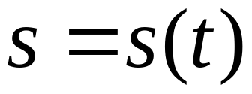
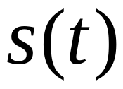
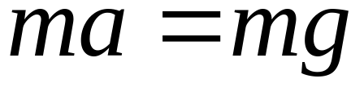

例 （落体问题）
在 t=0 时，物体位于 s=10m 处，物体的初速度 v₀=2m/sec （向下）
设物体只受重力作用，求物体的运动规律。
解
设物体的运动规律为：
未知函数
由牛顿第二定律：
a是加速度

Slide 4
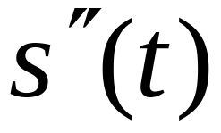

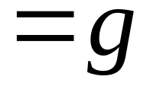
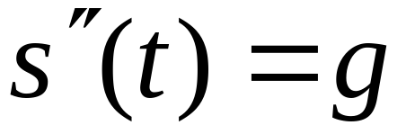
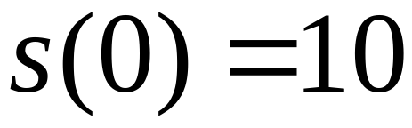
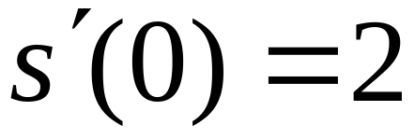
由导数的物理意义：
重力加速度
微分方程
二阶方程
初始位置
初始条件
初速度

Slide 5

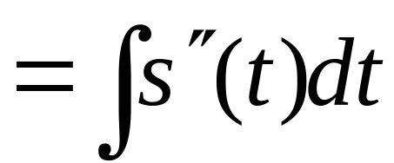
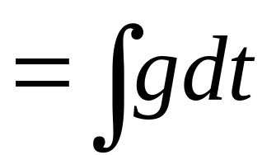
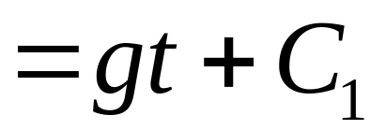
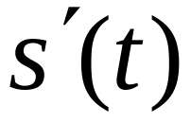
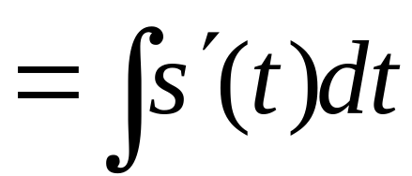
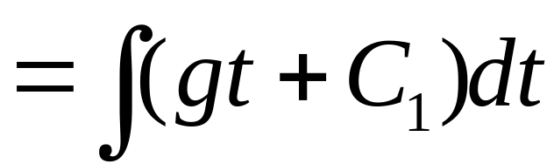
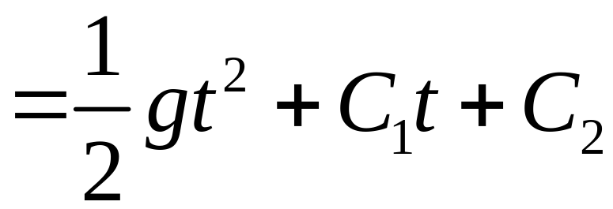
已知
求
积分：
再积分：
通解

Slide 6
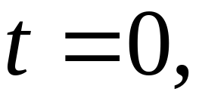
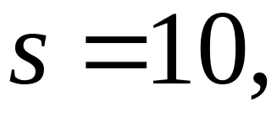
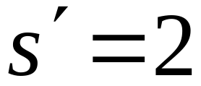
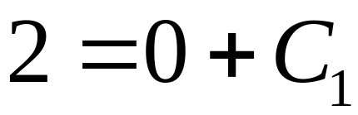
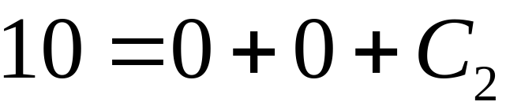
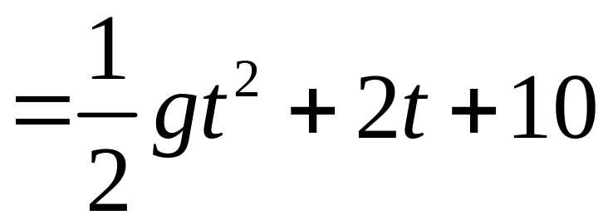
将
代入上式
特解：
这就是物体的运动方程

Slide 7
Newton 冷却定律 Newton’s Law of Cooling
物体的温度：u(t)
物体的初始温度：u(0)＝u₀
介质温度：T
气温、水温
Newton 冷却定律：
物体的冷却速度与物体的温度和
介质的温度之差成正比

Slide 8
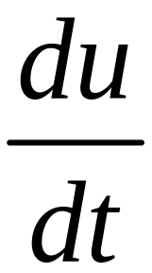
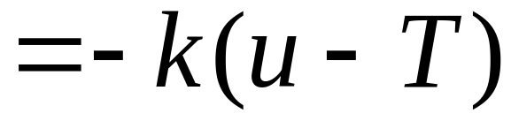
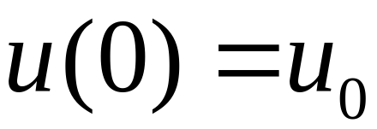
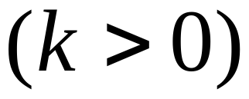
Newton 冷却定律：物体的冷却速度与
物体的温度和介质的温度之差成正比
微分方程：

Slide 9
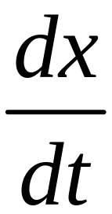
I 指数模型
设某一物质（人口、细菌、放射性元素）的总量 x
是时间的函数：
x = x(t) (未知)
已知：该物质的增长（减少）速度与该物质的总量
成正比，且已知在时刻 t=0 时，x(0) = x₀
求总量函数 x = x(t)
x 的增长（减少）速度：

Slide 10
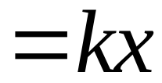
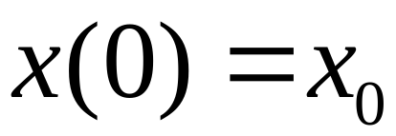
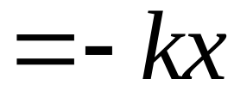
已知：该物质的增长（减少）速度与该物质的总量成正比，且已知在时刻 t=0 时，x(0) = x₀
建立微
分方程：
增长模型
The Law of Natural Growth
减少模型
同理
The Law of Natural Decay

Slide 11
传染病模型
Epidemics
早在1760年数学家Danial Bernoulli 就已经用
数学方法来研究传染病天花 （smallpox） 的
传播。
以下讨论一种最简单的传染病模型。

Slide 12
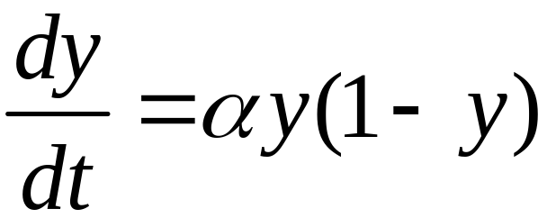
设有一种传染病在某一人群中传播。
设患病的人的比例为 y，未患病的人的比例
为 1- y
假设病人和非病人之间可以自由来往
则传染病传播的速度与 y(1-y)成正比
得微分方程：

Slide 13
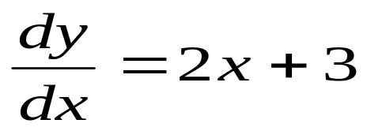
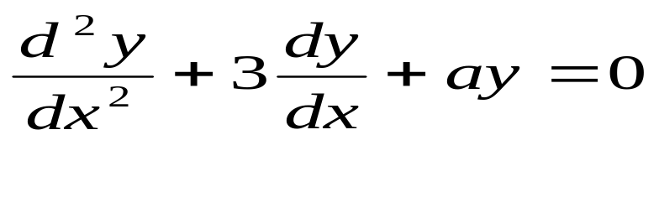
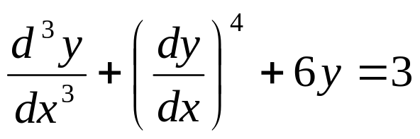
ordinary differential equations
Definition:
A differential equation is an equation containing an unknown function
and its derivatives.
Examples:.
1.
2.
3.
y is dependent variable and x is independent variable,
and these are ordinary differential equations

Slide 14
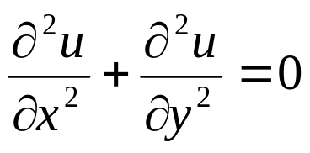
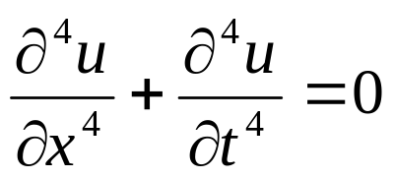
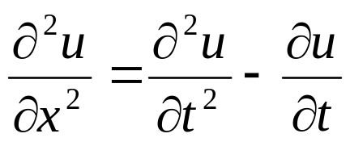
Partial Differential Equation
Examples:
1.
u is dependent variable and x and y are independent variables, and is partial differential equation.
2.
3.
u is dependent variable and x and t are independent variables

Slide 15
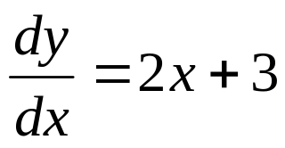
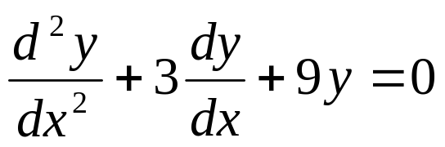
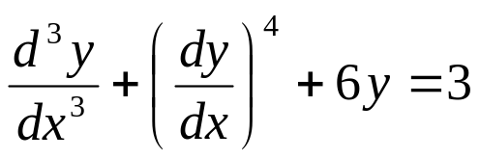
Order of Differential Equation
The order （阶） of the differential equation is order of the highest derivative in the differential equation.
Differential Equation ORDER （阶）
1
2
3

Slide 16
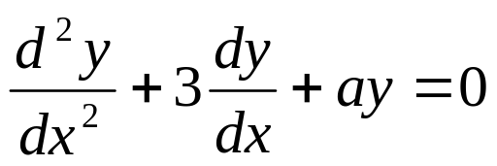
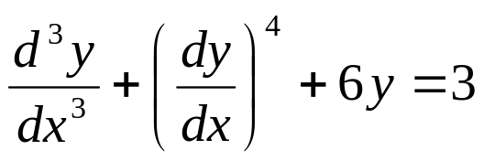
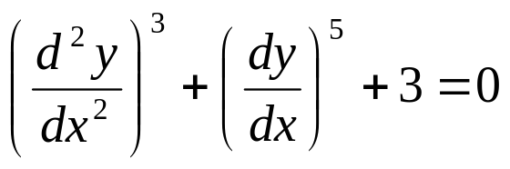
Degree of Differential Equation
The degree （次数）of a differential equation is power of the highest order derivative term in the differential equation.
Differential Equation Degree （次数）
1
1
3

Slide 17
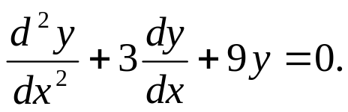
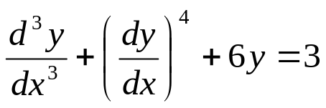
Linear Differential Equation
A differential equation is linear （线性）, if
  1. dependent variable and its derivatives are of degree one,
  2. coefficients of a term does not depend upon dependent variable.
Example:
1.
is linear.
Example:
2.
is non - linear because in 2nd term is not of degree one.

Slide 18
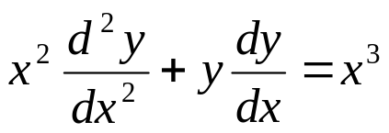
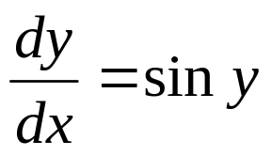
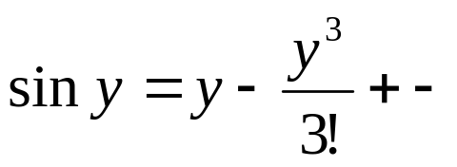
Example:
3.
is non - linear because in 2nd term coefficient depends on y.
Example:
4.
is non - linear because
is non – linear

Slide 19
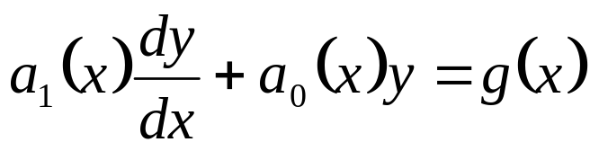
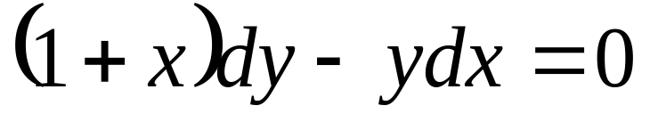
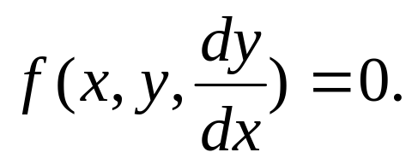

1st – order differential equation
1. Derivative form:
2. Differential form:
.
3. General form:
or
Notes:
Classfication of Differential Equation

Slide 20

Second order Ordinary Differential Equation
Notes:
Classfication of Differential Equation

Slide 21

nth – order linear differential equation
1. nth – order linear differential equation with constant coefficients.
2. nth – order linear differential equation with variable coefficients

Slide 22


Solution of Differential Equation
Differential Equation Chapter 1

Slide 23


Examples
y=3x+c, is solution of the 1st order differential equation , c₁ is arbitrary constant.
As is solution of the differential equation for every value of c₁, hence it is known as general solution.
Examples
Observe that the set of solutions to the above 1st order equation has 1 parameter, while the solutions to the above 2nd order equation depend on two parameters.

Slide 24


Differential Equation Chapter 1

Slide 25




Families of Solutions
Example
Solution
Observe that given any point (x₀,y₀), there is a unique solution curve of the above equation which curve goes through the given point.
The solution is a family of ellipses.

Slide 26


Slide 27

即便是一阶微分方程
也没有一种统一求解的方法。
微分方程必须根据不同的类型，
用不同的方法求解。
所以判别微分方程的类型十分重要。
本节将讨论几种常见类型的方程的解法。

